Slide 1
Day:5 Documentation Error Handling
Error handling is a crucial aspect of web development that enables us to anticipate, detect, and manage errors that may occur during execution. By implementing effective error handling mechanisms, we can prevent application crashes, data corruption, and security breaches.
Error handling ensures that our application:
Remains stable and reliable
Provides informative error messages
Recovers gracefully from errors
Maintains data integrity and security
By prioritizing error handling, we can deliver robust, reliable, and user-friendly applications that meet the highest standards of quality.

Slide 2
Search bar error handling
Objective:
Demonstrating How to implement search functionality with proper error handilng.
Key Focus:
Handling incorrect search queries. Showing a "No result found" message when no matches are found. Providing a seamless user experience even with invalid long search inputs

Slide 3
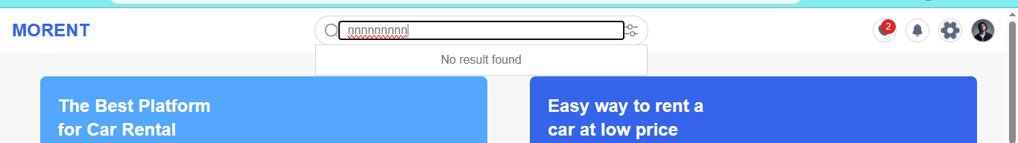
Why is Search with Error Handling Important?
Enhanced User Experience:
Users expect immediate feedback when searching.
Proper error handling prevents confusion and enhances usability.
Error Handling:
Informs the user when no results match their query.
Helps users refine their search or adjust their input.

Slide 4
Dynmaic Route Error Handling
API Failures & Invalid Responses: Handle errors when API calls fail or return invalid data, ensuring that the app doesn't break and provides clear error messages to users.
Loading States: Use loaders or spinners while data is being fetched, keeping users informed that content is loading and preventing a frozen UI experience.
Error Handling for Missing Data: Implement user-friendly messages like "Car not found" when data cannot be fetched due to network issues or when the resource doesn't exist.
Data Validation & Developer Logs: Ensure incoming data is validated for consistency and provide detailed logs for developers to debug errors effectively.

Slide 5
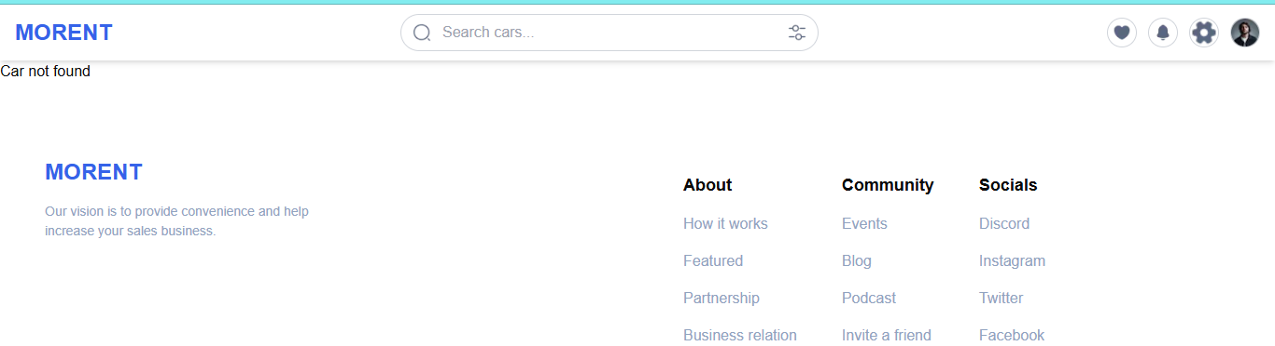
implement user-friendly messages like "Car not found" when data cannot be fetched due to network issues or when the resource doesn't exist.

Slide 6
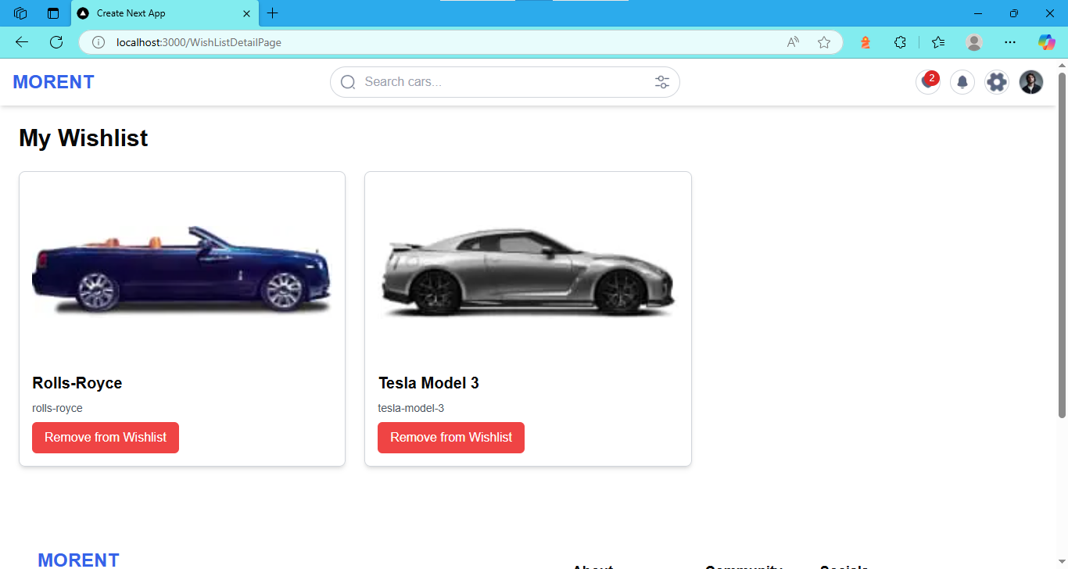
Add to wishlist error handling
Heart Icon Click Handling: Ensure that the heart icon functions properly when clicked. Handle scenarios where the icon doesn't toggle (red) due to UI or backend failures, such as network issues.
Notification Update on Wishlist Change: When an item is added to the wishlist, update the notification bar in the header to reflect the new quantity. Handle edge cases where the notification bar fails to update or displays incorrect data.
Navigating to Wishlist Page: Allow smooth navigation to the wishlist page when the heart icon is clicked in the header. Handle errors like navigation failures, improper data rendering, or blank pages when fetching wishlist data.Remove from Wishlist Functionality:

Slide 7
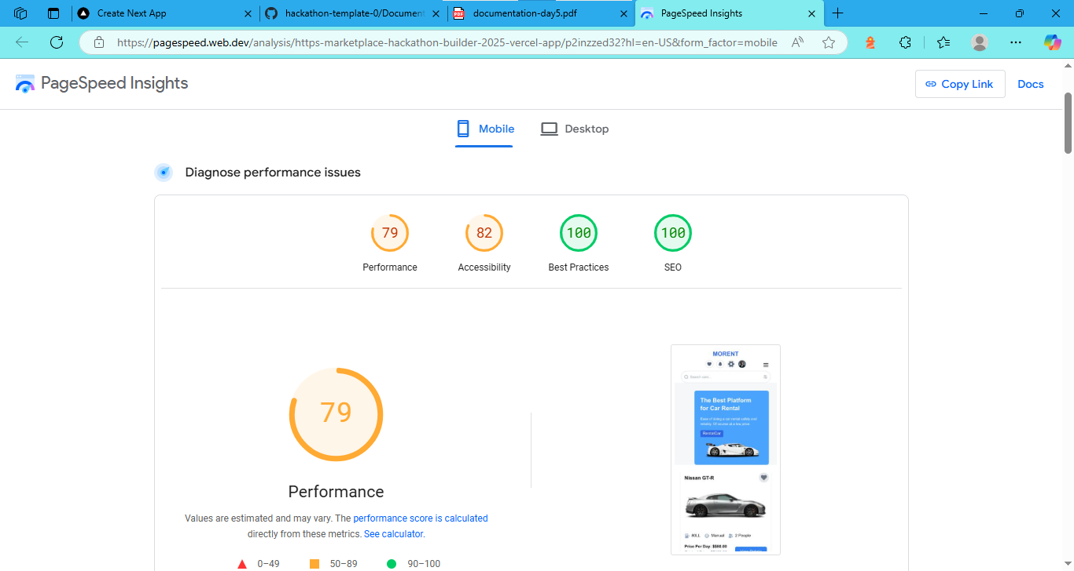
Performance: https://pagespeed.web.dev/analysis/https-marketplace-hackathon-builder-2025-vercel-app/p2inzzed32?hl=en-US&form_factor=mobile

Slide 8
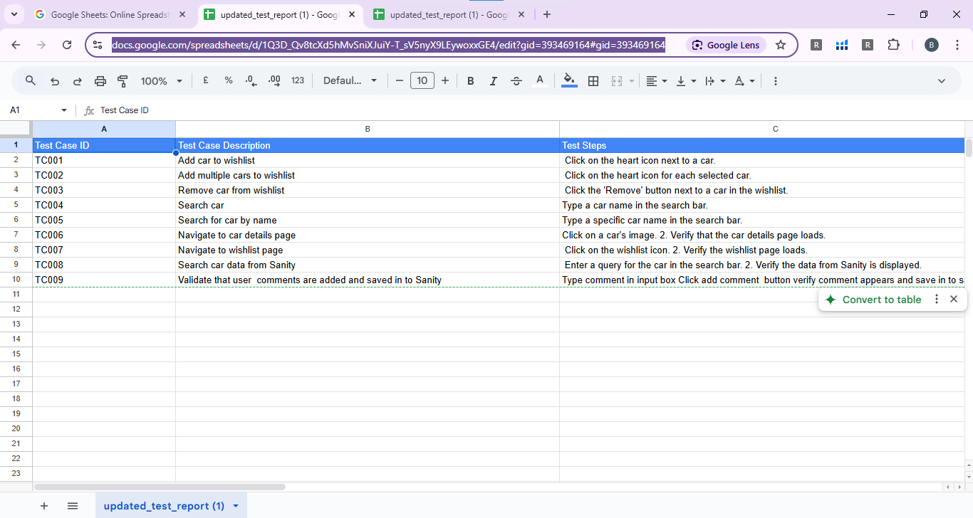
Csv:https://docs.google.com/spreadsheets/d/1Q3D_Qv8tcXd5hMvSniXJuiY-T_sV5nyX9LEywoxxGE4/edit?gid=393469164#gid=393469164
Prepare by :Bisma Naeem

